Slide 1

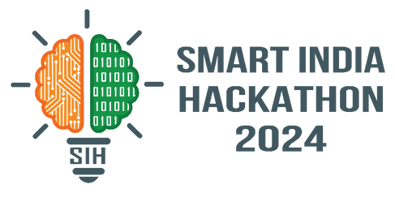

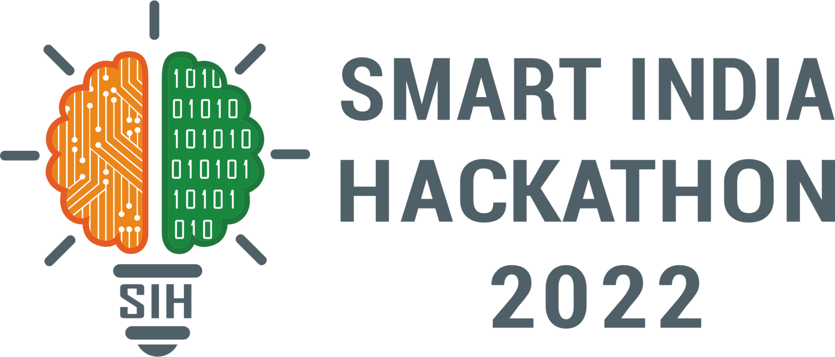
DRASHTA
SMART INDIA HACKATHON 2024
Problem Statement ID – 1598
Problem Statement Title- Student Innovation
Theme- Heritage & Culture
PS Category- Software
Team ID-
Team Name (Registered on portal)- Drashta
Please Follow this LINK for project overview and working prototype videos

Slide 2


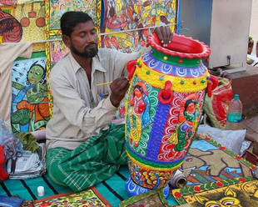
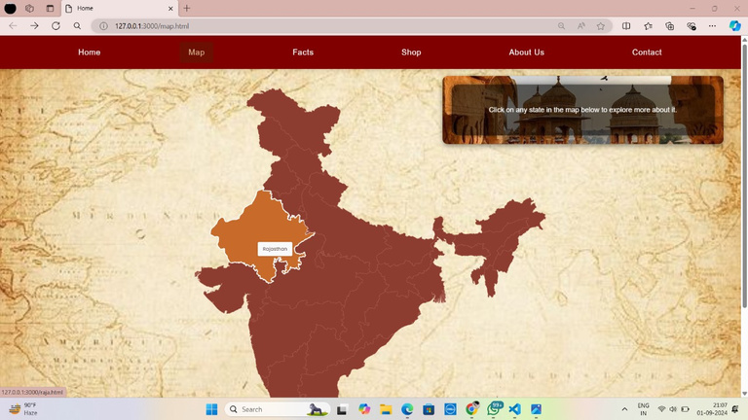

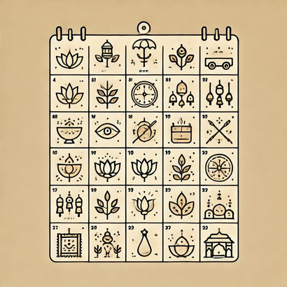
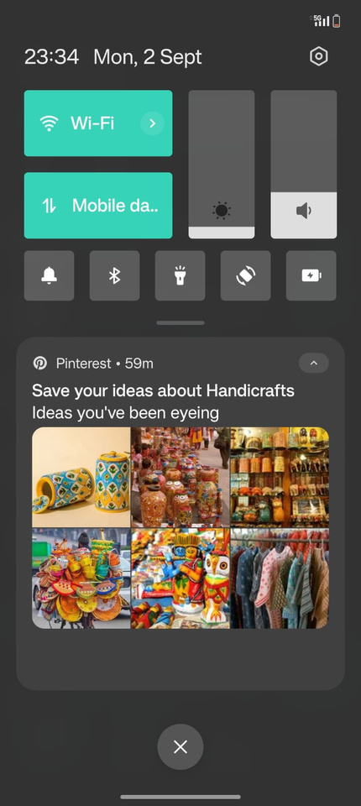

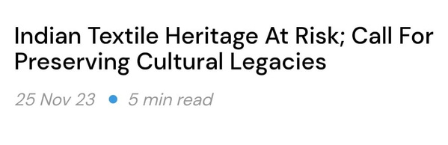
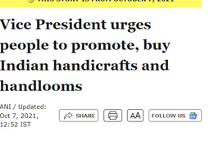
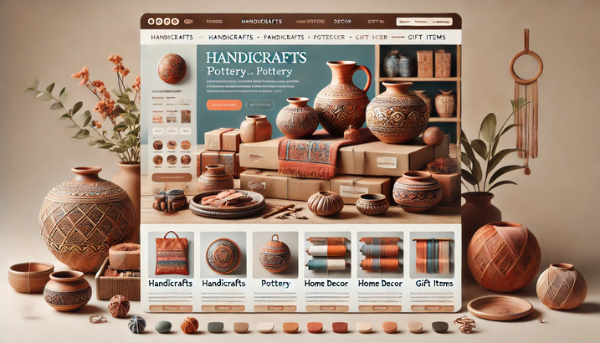
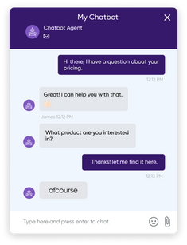
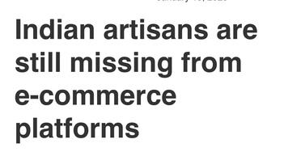
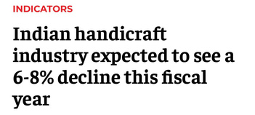
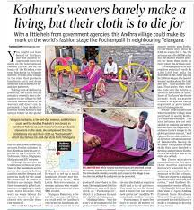

DRASHTA
PROPOSED SOLUTION:
PROBLEM: Culture At Risk?
Loss of Traditional Crafts: Diminishing recognition and market for Indian handicrafts, lack of digital know-how.
Lack of Cultural Awareness: Limited access to region-specific heritage knowledge.
Travel Planning Difficulties: Tedious, overwhelming process to plan trips tailored to cultural experiences.
Scattered/Fragmented Information: Disorganized resources on India's vast heritage, folklore, and monuments.
A cutting-edge platform designed to preserve, promote, and make accessible the rich cultural tapestry of India
Interactive Indian Map: Interactive state-specific exploration of food, monuments, folklore, and more promoting Unity In Diversity among learners.
AI-Powered Travel Guide (Indu): Personalized itineraries using AI for seamless, cultural travel planning.
Handicraft Marketplace: Promoting and selling authentic Indian traditional crafts directly to consumers thereby exposing local artisans to large global market.
Festival Calendar: A dynamic calendar showcasing upcoming Indian festivals, tailored to different regions and cultures.
@SIH Idea submission- Template
2

Slide 3
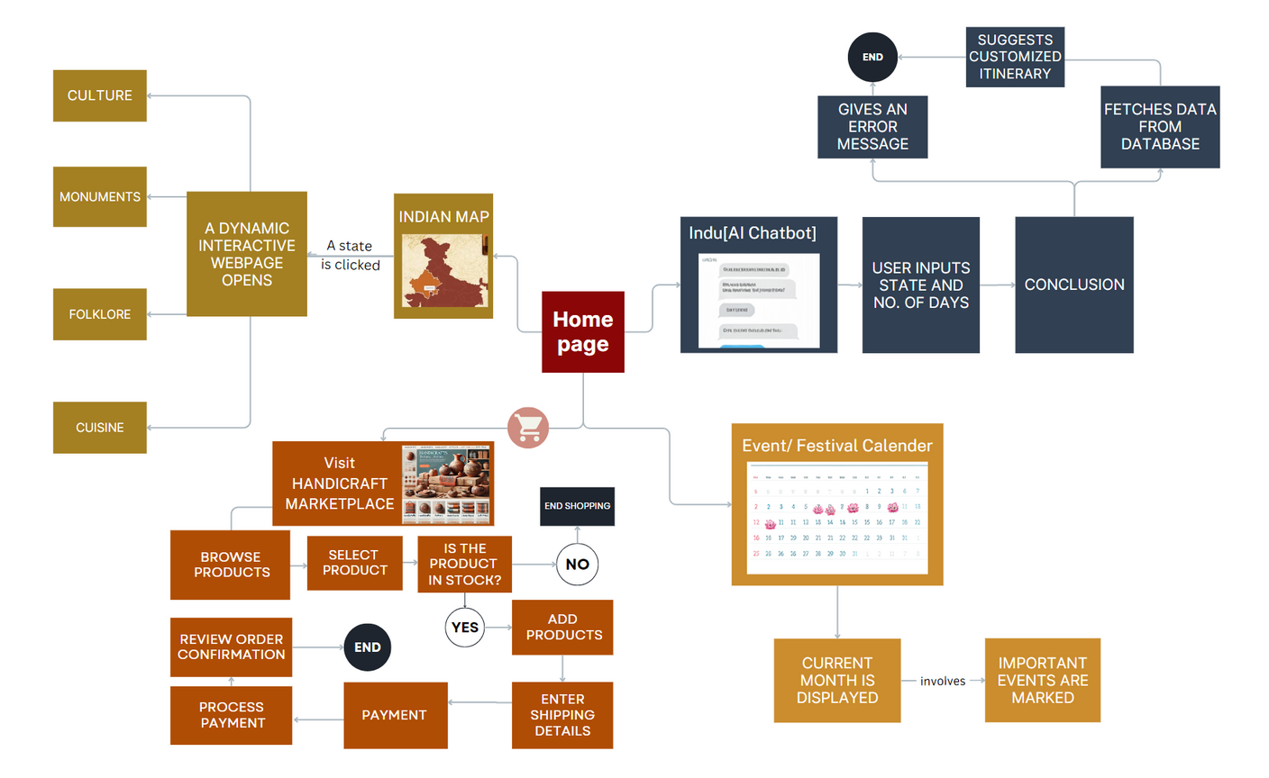








DRASHTA
Please Follow this LINK for project overview and working prototype videos
TECHNICAL FLOW
Tech Stack:
1. Front-End:
HTML5
CSS3
JavaScript
React.js
Bootstrap
2. Back-End:
Python
Flask
Node.js
3. Database:
MySQL
4. APIs/Integrations:
Chatbot Framework
Payment Gateway Integration
Event API
5. Cloud & Deployment:
AWS
Docker
6. Security:
JWT (JSON Web Tokens)
SSL/TLS
@SIH Idea submission- Template
3
Notes:
3

Slide 4


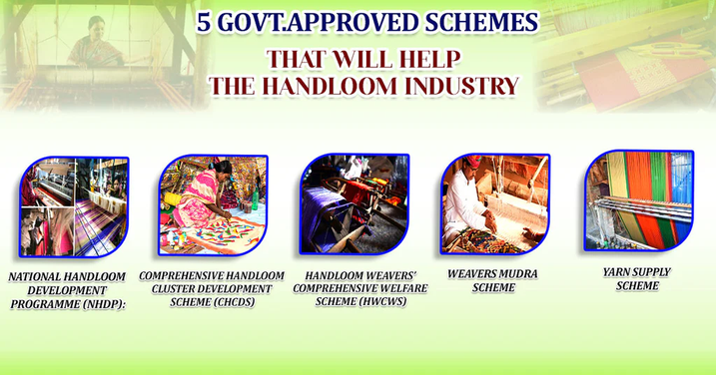


DRASHTA
Challenges & Strategies
FEASIBILITY & VIABILITY
Managing product listings, quality, and transactions can be challenging.
Market research to gauge interest, launch a limited selection, user feedback, use secure payment systems while providing clear policies.
The platform's framework enables easy expansion by adding more states, traditions, and artisans over time without raising costs or complexity significantly.
The global market for handmade products was valued at $718 billion in 2021, with a projected growth rate of 20% by 2030 highlighting the need for such platforms.
Ensuring accuracy by using trusted government sites and working with cultural consultants for content validation.
Risk of misrepresentation or cultural insensitivity.
Getting local artisans to use and engage with the app can be challenging
Build a community by organizing events and networking opportunities that connect them with other artisans and potential buyers.
Demand for Authentic Products: Consumers are increasingly seeking out authentic, handmade products rather than mass-produced.
Competing with established e-commerce and cultural platforms.
The Indian map and chatbot deliver personalized travel tips, merging education with commerce and enriching shopping experience with cultural insights.
Govt. initiatives such as "One District, One Product" and the "National Handloom Development Programme" support local artisans with strong policy backing.
@SIH Idea submission- Template
4
@SIH Idea submission- Template
4

Slide 5



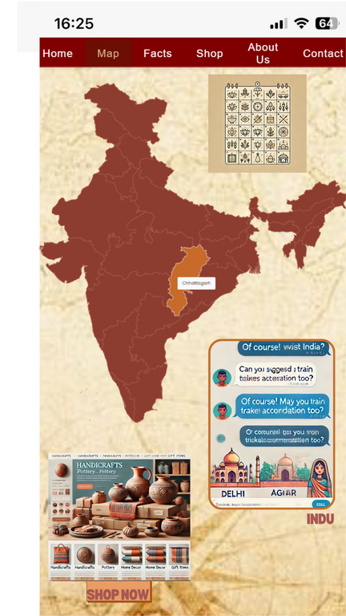
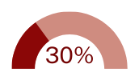

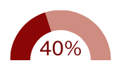


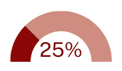
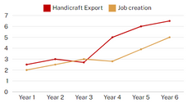

DRASHTA
IMPACT AND BENEFITS
SHOW STOPPERS
Awareness through
Interactive Exploration:
The map encourages users to explore India's rich heritage by clicking on states, uncovering their unique traditions, languages, and monuments, fostering greater cultural appreciation.
Event Calendar Integration:
Centralized event calendar keeps users informed about key cultural events, driving repeat visits and targeted marketing opportunities.
SOCIAL BENEFITS:
Increase in artisans' exposure
Strengthens community ties, cultural exchange
Rise in awareness of India's diverse heritage
Cultural Commerce
Integration:
Ensures verified, high-quality handicrafts while seamlessly blending cultural exploration with e-commerce, allowing users to discover and purchase rare regional crafts with ease.
AI Chatbot
(Indu):
Personalized travel guide and itinerary planner improves user satisfaction and provides valuable data insights for service enhancement.
ECONOMIC BENEFITS:
Boost in Artisan wages
Rise in handicraft export contribution from 3% to 5-7%.
Generation of 10,000-15,000 new jobs
25-35% increase in sales
@SIH Idea submission- Template
5
Notes:
5

Slide 6

DRASHTA
RESEARCH AND REFERENCES
Economic Times Article
Handicrafts Website
Article 1- Challenges
Article 2- Roles in economy
Article 3- Former Vice President encouraging handicrafts
@SIH Idea submission- Template
6
Notes:
6

Slide 7
IMPORTANT INSTRUCTIONS
Please ensure below pointers are met while submitting the Idea PPT:
Kindly keep the maximum slides limit up to six (6). ( Including the title slide)
Try to avoid paragraphs and post your idea in points /diagrams / Infographics /pictures
Keep your explanation precise and easy to understand
Idea should be unique and novel.
You can only use provided template for making the PPT without changing the idea details pointers (mentioned in previous slides).
You need to save the file in PDF and upload the same on portal. No PPT, Word Doc or any other format will be supported.
Note - You can delete this slide (Important Pointers) when you upload the details of your idea on SIH portal.
@SIH Idea submission- Template
7
Notes:
7

